Slide 1
Maths Daily Practice
Grade 1 - Week 2
Complete this work in a notebook at home. This is not mandatory homework.
Therefore, it does not need bringing into school. This is optional practice to support the learning taking place in school.

Slide 2
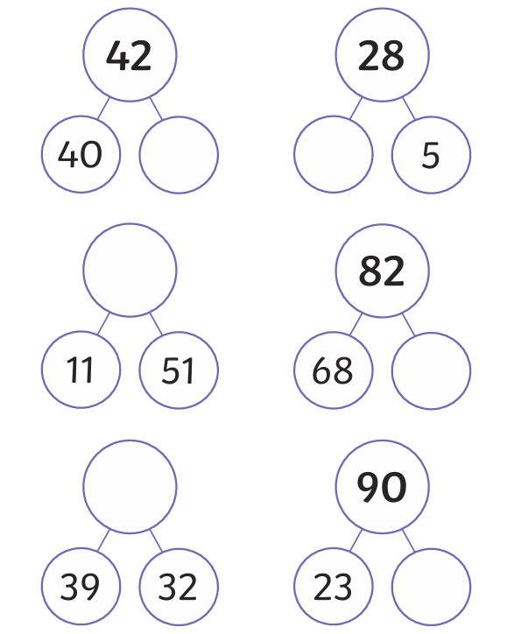

Daily practice 1
Partitioning into tens and ones
Complete the part-whole models by writing the correct numbers in the spaces.

Slide 3
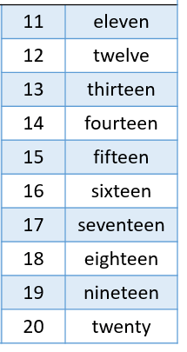
Daily practice 2
Number spelling
Many numbers do not follow simple phonetic rules. Therefore, students must practice and remember how to spell numbers to 20.
Practice writing these numbers and then test your child to see if they can remember their spellings without looking.

Slide 4
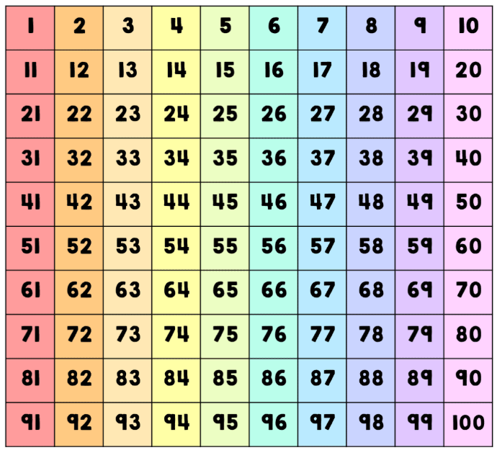
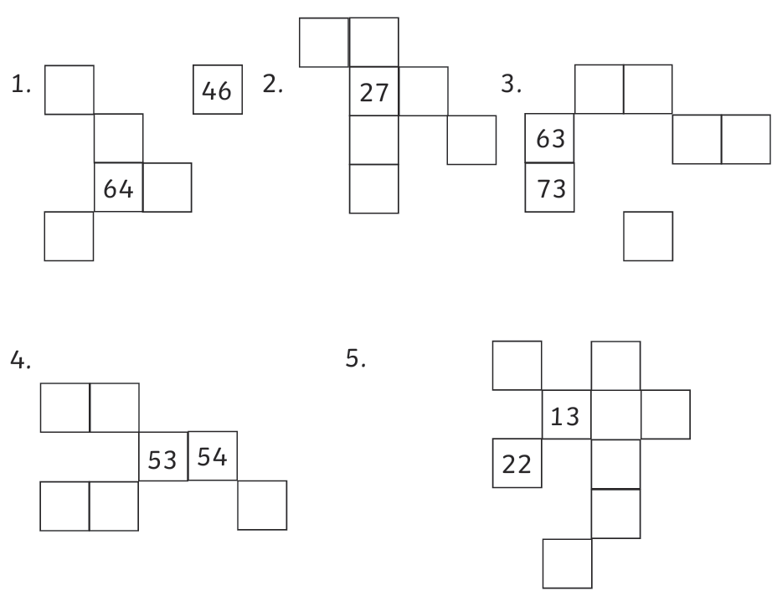
Daily practice 3
Place Value
Use a 100s grid and place value understanding to find the missing numbers.

Slide 5
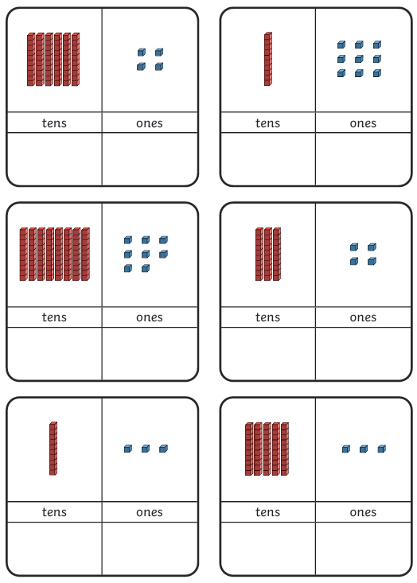
Daily practice 4
Tens and Ones
Count the tens and ones, then add them together to make a 2-digit number.

Slide 6
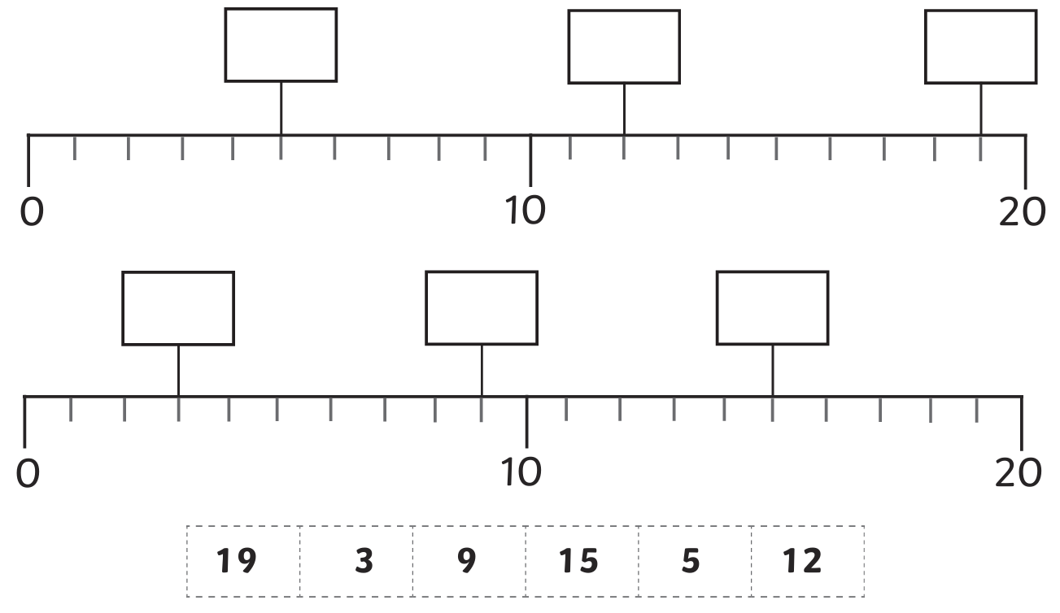
Daily practice 5
Using a number line
Use your understanding of counting in 1s to place the numbers onto their correct position on the two number lines.

